Slide 1
Unit-II
BUSINESS INTELLIGENCE

Slide 2
Unit-II
Business Intelligence: Introduction to Business Intelligence: Define Business Intelligence, The
Architecture of BI, Components of BI, ETL process, Define business analytics, Difference between
Business Intelligence and Business analytics. Different BI Tools, Leveraging Data and Knowledge
for BI, Business Intelligence and Business Analytics

Slide 3
Introduction to Business Intelligence
Business intelligence (BI) is software that ingests business data and presents it in user-friendly views such as reports, dashboards, charts and graphs.
Business intelligence combines business analytics, data mining, data visualization, data tools and infrastructure, and best practices to help organizations make more data-driven decisions.

Slide 4
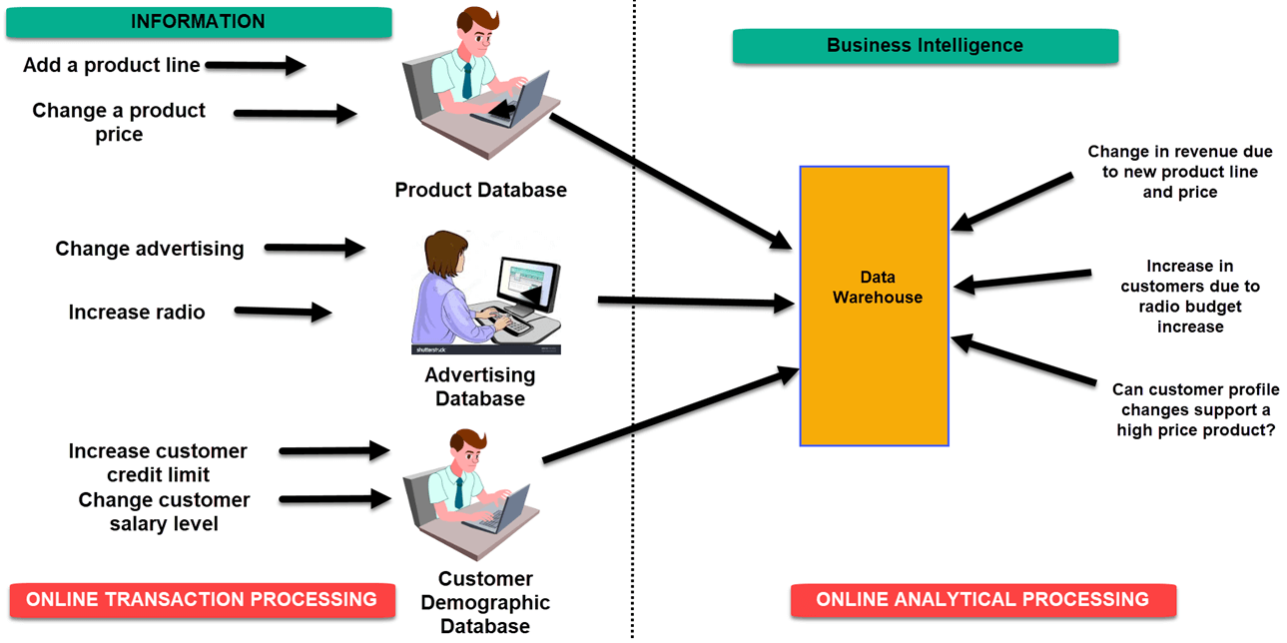
Differences between information and BI

Slide 5
Define Business Intelligence
Business intelligence data is typically stored in a data warehouse built for an entire organization or in smaller data marts that hold subsets of business information for individual departments and business units, often with ties to an enterprise data warehouse.

Slide 6
Definition
Business intelligence (BI) is a technology-driven process for analyzing data and delivering actionable information that helps executives, managers and workers make informed business decisions.

Slide 7
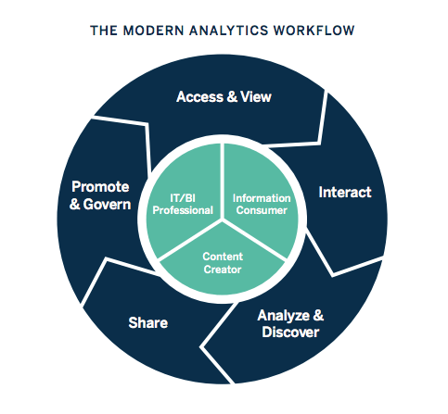
Work flow

Slide 9
Business Environment Factors that Create Pressures on Organizations
Factor Description
Markets Strong competition
Expanding global markets
Consumer demands
Technology
Societal
Booming electronic markets on the Internet
Innovative marketing methods
Opportunities for outsourcing with Information Technology (IT) support
Need for real-time, on-demand transactions
Desire for customization
Desire for quality, diversity of products, and speed of delivery
Customers getting powerful and less loyal
More innovations, new products, and new services
Increasing obsolescence rate
Increasing information overload
Social networking, Web 2.0 and beyond
Growing government regulations and deregulation
Workforce more diversified, older, and composed of more women
Prime concerns of homeland security and terrorist attacks
Necessity of Sarbanes-Oxley Act and other reporting-related legis lation
Increasing socia l responsibility of companies
Greater emphasis on sustainability

Slide 10
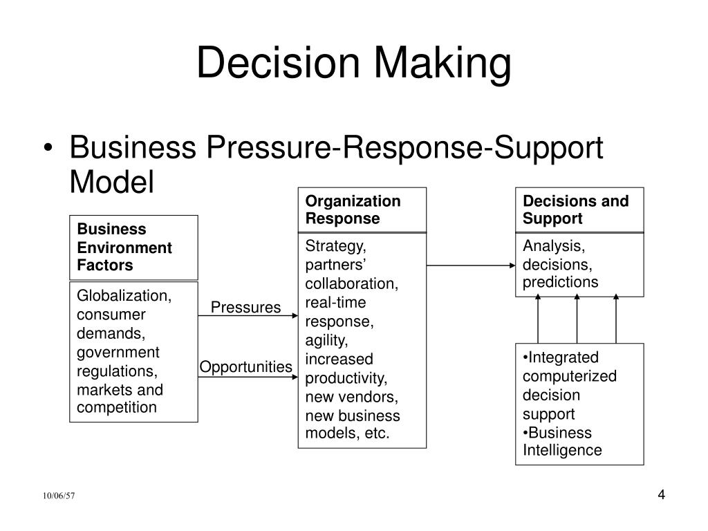
BI

Slide 11
THE BUSINESS ENVIRONMENT The environment in which organizations operate today is
becoming more and more complex. This complexity creates opportunities on the one
hand and problems on the other. Take globalization as an example. Today, you can easily
find suppliers and customers in many countries, which means you can buy cheaper
materials and sell more of your products and se1v ices; great opportunities exist.

Slide 12
BI
BI can be used to uncover trends and guide the development of marketing campaigns. As the campaigns are completed, Phocas can be used to assess the campaign's effectiveness. Having an accurate assessment allows your team to optimize your marketing budget.

Slide 13
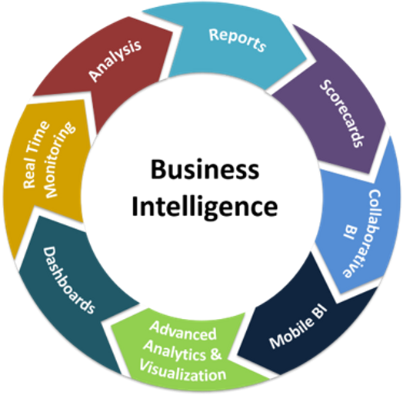
BI

Slide 14
A business intelligence architecture is a framework for the various technologies an organization deploys to run business intelligence and analytics applications. It includes the IT systems and software tools that are used to collect, integrate, store and analyze BI data and then present information on business operations and trends to corporate executives and other business users.

Slide 15
Architecture of BI
Business intelligence (BI) is a technology-driven process for analyzing data and delivering actionable information that helps executives, managers and workers make informed business decisions.

Slide 16
Benefits of BI architecture
Benefits of BI architecture
In the absence of a BI architecture, businesses and enterprises are at risk of making costly errors while striving to optimize their data utilization.
A well-articulated BI framework can offer organizations the following key benefits:
Technology benchmarks. A BI architecture articulates the technology standards and data management and business analytics practices that support an organization's BI efforts, as well as the specific platforms and tools deployed.
Improved decision-making. Enterprises benefit from an effective BI architecture by using the insights generated by business intelligence tools to make data-driven decisions that help increase revenue and profits.
Technology blueprint. A BI framework serves as a technology blueprint for collecting, organizing and managing BI data and then making the data available for analysis, data visualization and reporting. A strong BI architecture automates reporting and incorporates policies to govern the use of the technology components.
Enhanced coordination. Putting such a framework in place enables a BI team to work in a coordinated and disciplined way to build an enterprise BI program that meets the organization's data analytics needs. The BI architecture also helps BI and data managers create an efficient process for handling and managing the business data that's pulled into the environment.
Time savings. By automating the process of collecting and analyzing data, BI helps organizations save time on manual and repetitive tasks, freeing up their teams to focus on more high-value projects.
Scalability. An effective BI infrastructure is easily scalable, enabling businesses to change and expand as necessary.

Slide 17
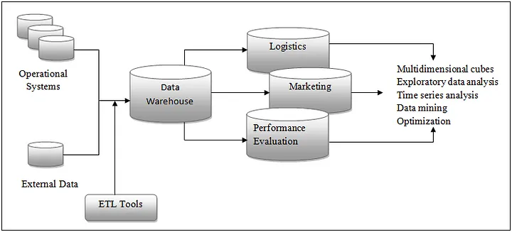
Architecture

Slide 18
Business Intelligence system includes three major components:
Data Source
Data Warehouse and Data Marts
Business Intelligence Methodologies

Slide 19
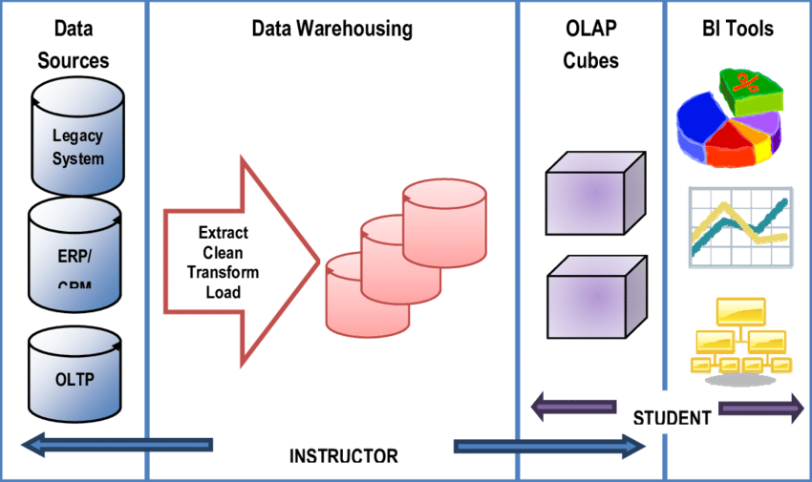
Architecture

Slide 20
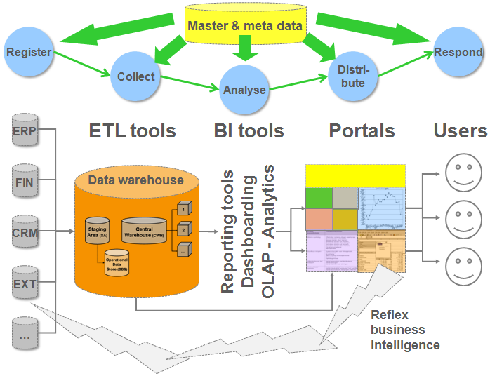
BI architecture

Slide 21
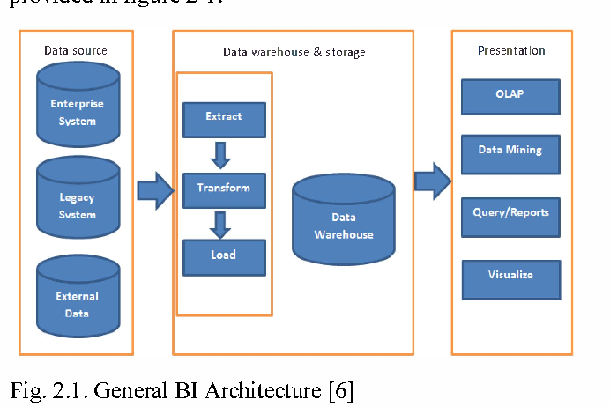

Slide 22
BI Architecture
BI Architecture
Business intelligence architecture is the framework that organizations deploy for collecting data, administering of information and supporting all the technologies of business intelligence. A successful business intelligence tool depends majorly upon a sustainable architecture. The process of creating a BI architecture is divided into three areas:
Data collection: This area is responsible for collecting variety of data from different activities carried out in your organization. It involves understanding of data required for different users. It is also important to examine the quality and type of data you are collecting. The quality of data collected reflects directly into the BI insights.
Information Management: This includes integration of data, scraping datasets, arranging the structure and administration of data.
Business Intelligence: Business Intelligence is that part of an organizational architecture which analyzes properly organized data to produce insights about the state of the business.

Slide 23
Components of BI:
There are five components of Business Intelligence. They are:
OLAP (Online Analytical Processing): It helps executives in sorting and selecting aggregate of data in order to monitor it strategically.
Corporate Performance Management (CPM)/Advanced Analytics: This tool helps with the statistics of certain product or service. It also helps in predicting the performance of particular product in market.
Real-time BI: Real time BI helps businesses in keeping updated with the changing marketing trends. While clients are engaged on the website, marketing team can announce special offers and grab client’s attention. This is possible with real-time BI
Data warehousing: It involves storage of large amounts of data to the benefit of different divisions of an organization.
Data sources: This involves taking raw data and creating systematic data sources with the help of various software applications. BI tools put these datasets to create pie charts, graphs or tables etc.

Slide 24
Benefits of BI:
Organizations can use BI tools at any stage to analyze, manage and visualize business data through which they can stay relevant and maximize their revenue streams. Following are the key benefits of BI:
Quick and accurate reporting
Delivering business insights that add value to the businesses
Insightful data analysis
Improving data quality
Enhancing operational data efficiency
Achieving customer satisfaction
Understanding market trends and improving decision making process
Lower margins and increasing business revenues

Slide 25
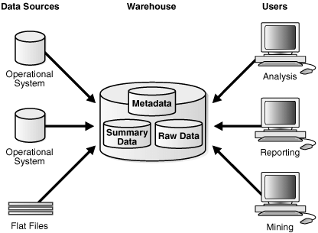
components

Slide 26
ETL Process in Data Warehouse
INTRODUCTION:
ETL stands for Extract, Transform, Load and it is a process used in data warehousing to extract data from various sources, transform it into a format suitable for loading into a data warehouse, and then load it into the warehouse. The process of ETL can be broken down into the following three stages:
Extract: The first stage in the ETL process is to extract data from various sources such as transactional systems, spreadsheets, and flat files. This step involves reading data from the source systems and storing it in a staging area.
Transform: In this stage, the extracted data is transformed into a format that is suitable for loading into the data warehouse. This may involve cleaning and validating the data, converting data types, combining data from multiple sources, and creating new data fields.
Load: After the data is transformed, it is loaded into the data warehouse. This step involves creating the physical data structures and loading the data into the warehouse.
The ETL process is an iterative process that is repeated as new data is added to the warehouse. The process is important because it ensures that the data in the data warehouse is accurate, complete, and up-to-date. It also helps to ensure that the data is in the format required for data mining and reporting.
Additionally, there are many different ETL tools and technologies available, such as Informatica, Talend, DataStage, and others, that can automate and simplify the ETL process.
ETL is a process in Data Warehousing and it stands for Extract, Transform and Load. It is a process in which an ETL tool extracts the data from various data source systems, transforms it in the staging area, and then finally, loads it into the Data Warehouse system.

Slide 27
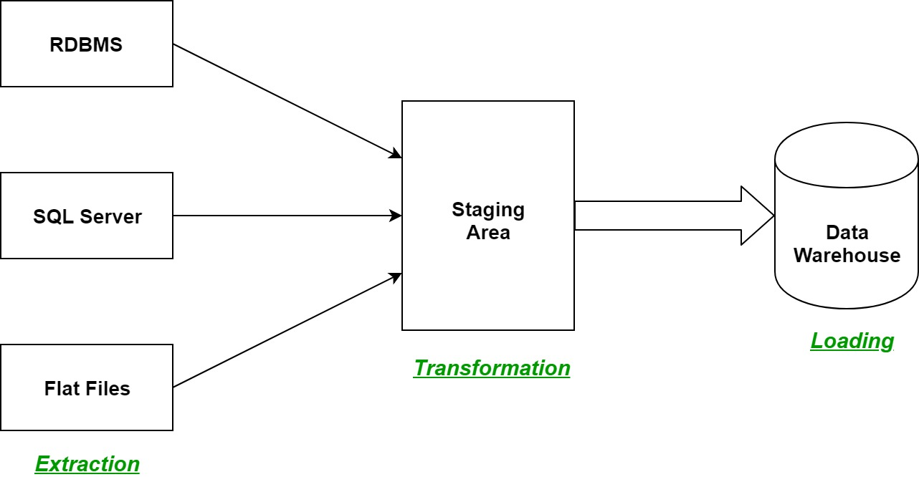

Slide 28
ETL
Extract, transform, and load (ETL) is the process of combining data from multiple sources into a large, central repository called a data warehouse. ETL uses a set of business rules to clean and organize raw data and prepare it for storage, data analytics, and machine learning (ML).

Slide 29
ETL process:
What are the 5 steps of the ETL process in order?
What is ETL Data Integration? Understand the ETL Process ...
The 5 steps of the ETL process are: extract, clean, transform, load, and analyze. Of the 5, extract, transform, and load are the most important process steps.

Slide 30
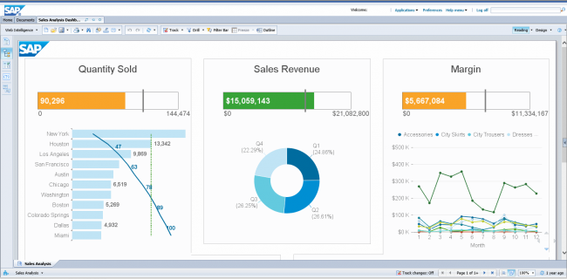
Top 15 Business Intelligence Tools : An Overview
1. SAP Business Objects

Slide 31
SAP
SAP Business Objects is a business intelligence software which offers comprehensive reporting, analysis and interactive data visualisation. The platform focuses heavily on categories such as Customer Experience (CX) and CRM, digital supply chain, ERP and more. What’s really nice about this platform is the self-service, role-based dashboards its offers enabling users to build their own dashboards and applications. SAP is a robust software intended for all roles (IT, end uses and management) and offers tons of functionalities in one platform. The complexity of the product, however, does drive up the price so be prepared for that.

Slide 32
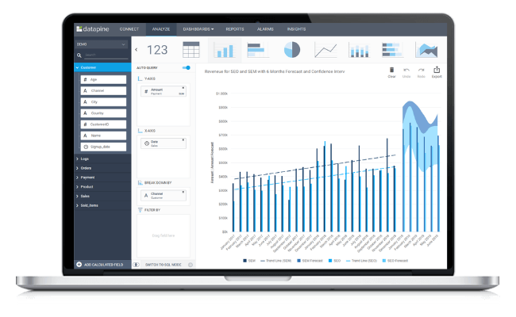
2. Datapine

Slide 33
DATAPINE
Datapine is an all-in-one business intelligence platform that facilitates the complex process of data analytics even for non-technical users. Thanks to a comprehensive self-service analytics approach, datapine’s solution enables data analysts and business users alike to easily integrate different data sources, perform advanced data analysis, build interactive business dashboards and generate actionable business insights.

Slide 34
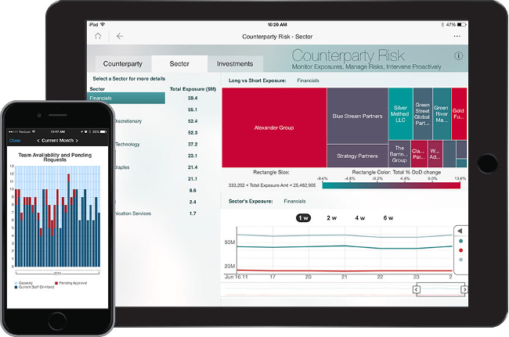
3. MicroStrategy

Slide 35
MS
MicroStrategy is an enterprise business intelligence tool that offers powerful (and high speed) dashboarding and data analytics, cloud solutions and hyperintelligence. With this solution, users can identify trends, recognise new opportunities, improve productivity and more. Users can also connect to one or various sources, whether the incoming data is from a spreadsheet, cloud-based or enterprise data software. It can be accessed from your desktop or via mobile. Setup, however can involve multiple parties and some rather extensive knowledge of the application in order to get started.
Website: www.microstrategy.com

Slide 36
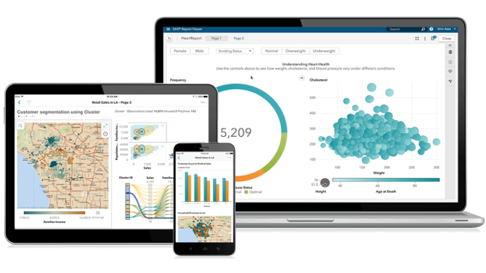
SAS Business Intelligence

Slide 37
SAS
While SAS’ most popular offering is its advanced predictive analytics, it also provides a great business intelligence platform. This well-seasoned self-service tool, which was founded back in the 1970s, allows users to leverage data and metrics to make informed decisions about their business. Using their set of APIs, users are provided with lots of customisation options, and SAS ensures high-level data integration and advanced analytics & reporting. They also have a great text analytics feature to give you more contextual insights into your data.
Website: www.sas.com

Slide 38
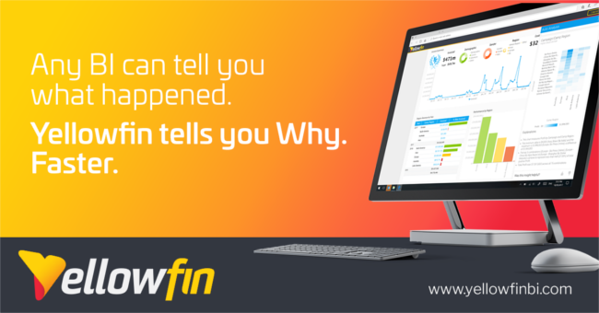
Yellowfin BI

Slide 39
YELLOW
Yellowfin BI is a business intelligence tool and ‘end-to-end’ analytics platform that combines visualisation, machine learning, and collaboration. You can also easily filter through tons of data with intuitive filtering (e.g. checkboxes and radio buttons) as well open up dashboards just about anywhere (thanks to this tool’s flexibility in accessibility (mobile, webpage, etc.). The nice thing about this BI tool is that you can easily take dashboards and visualisations to the next level using a no code/low code development environment.
Website: www.yellowfinbi.com

Slide 40
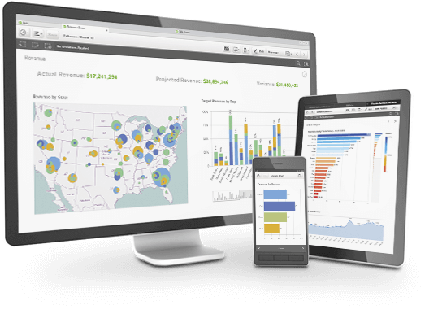
QlikSense

Slide 41
QLIK
A product of Qlik, QlikSense is a complete data analytics platform and business intelligence tool. You can use QlikSense from any device at any time. The user interface of QlikSense is optimised for touchscreen, which makes it a very popular BI tool. It offers a one-of-a-kind associative analytics engine, sophisticated AI and high performance cloud platform, making it all the more attractive. An interesting feature within this platform is its Search & Conversational Analytics which enables a faster and easier way to ask questions and discover new insights by way of natural language.
Website: www.qlik.com

Slide 42
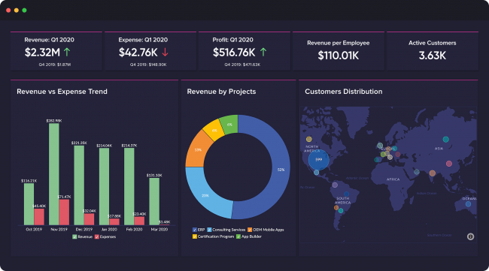
7. Zoho Analytics

Slide 43
Zoho Analytics is great BI tool for in-depth reporting and data analysis. This business intelligence tool has automatic data syncing and can be scheduled periodically. You can easily build a connector by using the integration APIs. Blend and merge data from different sources and create meaningful reports. With an easy editor you create personalised reports and dashboards enabling you to zoom into the important details. It also offers a unique commenting section in the sharing options which is great for collaboration purposes.
Website: www.zoho.com/analytics

Slide 44
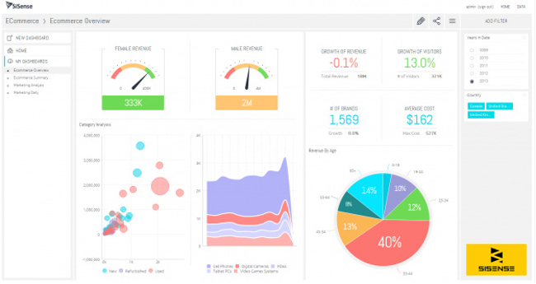
Sisense

Slide 45
SISENSE
Sisense is a user-friendly data analytics and business intelligence tool that allows anyone within your organisation to manage large and complex datasets as well as analyse and visualise this data without your IT department getting involved. It lets you bring together data from a wide variety of sources as well including Adwords, Google Analytics and Salesforce. Not to mention, because it uses in-chip technology, data is processed quite quickly compared to other tools. Thi splatform is even recognised as a leading cloud analytics platform by various industry experts such as Gartner, G2 and Dresner.
Website: www.sisense.com

Slide 46
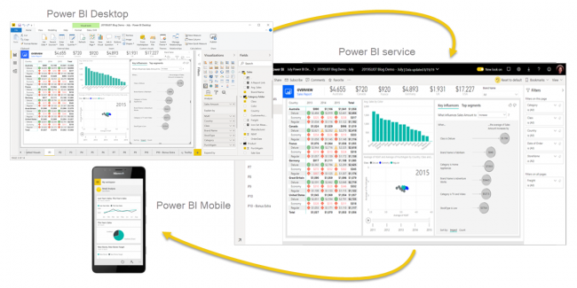
9. Microsoft Power BI

Slide 47
Power BI
Microsoft Power BI is a web-based business analytics tool suite which excels in data visualisation. It allows users to identify trends in real-time and has brand new connectors that allow you to up your game in campaigns. Because it’s web-based, Microsoft Power BI can be accessed from pretty much anywhere. This software also allows users to integrate their apps and deliver reports and real-time dashboards.
Website: www.powerbi.microsoft.com

Slide 48
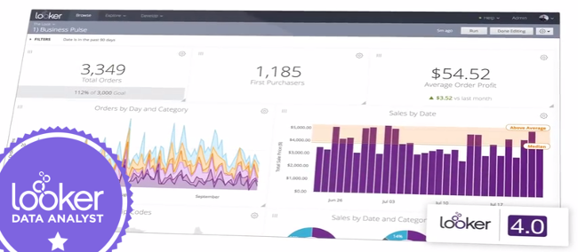
10. Looker

Slide 49
Data discovery app, Looker is another business intelligence tool to look out for! Now part of Google Cloud, this unique platform integrates with any SQL database or warehouse and is great for startups, midsize-businesses or enterprise-grade businesses. Some benefits of this particular tool include ease-of-use, handy visualisations, powerful collaboration features (data and reports can be shared via email or USL as well as integrated with other applications), and reliable support (tech team).
Website: www.looker.com

Slide 50

11. Clear Analytics

Slide 51
This is for all of the Excel-lovers out there…This BI tool is an intuitive Excel-based software that can be used by employees with even the most basic knowledge of Excel. What you get is a self-service Business Intelligence system that offers several BI features such as creating, automating, analysing and visualisation your company’s data. This solution also works with the aforementioned Microsoft Power BI, using Power Query and Power Pivot to clean and model different datasets.
Website: www.clearanalyticsbi.com

Slide 52
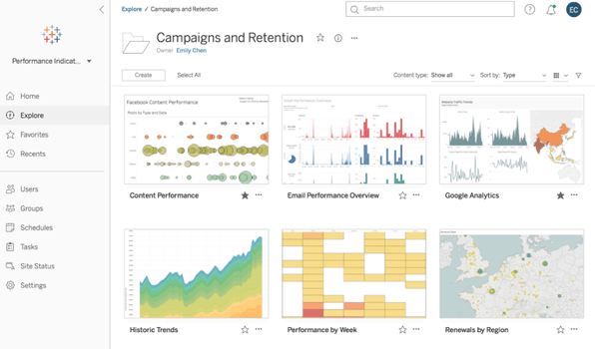
12. Tableau

Slide 53
Tableau is a Business Intelligence tool specialised in data discovery and data visualisation. With the software you can easily analyse, visualise and share data, without IT having to intervene. Tableau supports multiple data sources such as MS Excel, Oracle, MS SQL, Google Analytics and SalesForce. Users will gain access to well-designed dashboards that are very easy to use. Additionally Tableau also offers several standalone products including Tableau Desktop (for anyone) and Tableau Server (analytics for organisations), which can be run locally, Tableau Online (hosted analytics for organisations) and many more.
Website: www.tableau.com

Slide 54
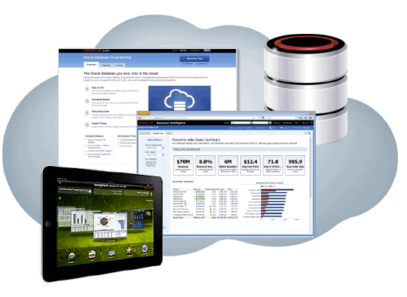
13. Oracle BI

Slide 55
Oracle BI is an enterprise portfolio of technology and applications for business intelligence. This technology gives users pretty much all business intelligence capabilities, such as dashboards, proactive intelligence, ad hoc, and more. Oracle is also great for companies who need to analyse large data volumes (from Oracle and non-Oracle sources) as it is a very robust solution. Additional key features include data archiving, versioning, a self-service portal and alerts/notifications.
Website: www.oracle.com

Slide 56
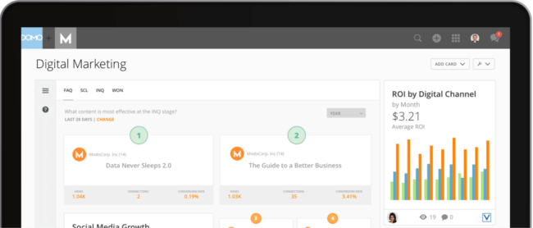
14. Domo

Slide 57
Domo is a completely cloud-based business intelligence platform that integrates multiple data sources, including spreadsheets, databases and social media. Domo is used by both small companies and large multinationals. The platform offers micro and macro level visibility and analyses (including predictive analysis powerd with Mr. Roboto, their AI engine). From cash balances and listings of your best selling products by region to calculations of the marketing return on investment (ROI) for each channel. The only setbacks with Domo are the difficulty in downloading analyses from the cloud for personal use and the steep learning curve.
Website: www.domo.com

Slide 58
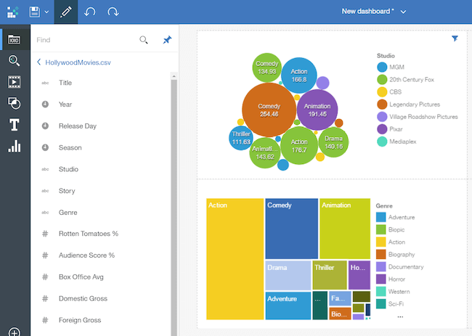
15. IBM Cognos Analytics

Slide 59
Cognos Analytics is an AI-fueled business intelligence platform that supports the entire analytics cycle. From discovery to operationalisation, you can visualise, analyse and share actionable insights about your data with your colleagues. A great benefit of AI is that you are able to discover hidden patterns, because the data is being interpreted and presented to you in a visualized report. Keep in mind, however, that it can take a while to get familiar with all of the features within this solution.
Website: www.ibm.com

Slide 60
Data analysis
Data analysis is the methodical exploration and interpretation of data, underpins decision-making in today’s dynamic landscape. As the demand for skilled Data Analysts grows, understanding the six key steps in this process becomes imperative. From defining problems to presenting insights, each step plays a vital role in transforming raw data into actionable knowledge.
In this article let’s delve into the six essential steps of data analysis, emphasizing the significance of each phase in extracting meaningful conclusions.

Slide 61
The collection, transformation, and organization of data to draw conclusions make predictions for the future and make informed data-driven decisions is called Data Analysis. The profession that handles data analysis is called a Data Analyst.
There is a huge demand for Data Analysts as the data is expanding rapidly nowadays. Data Analysis is used to find possible solutions for a business problem. The advantage of being a Data Analyst is that they can work in any field they love healthcare, agriculture, IT, finance, business. Data-driven decision-making is an important part of Data Analysis. It makes the analysis process much easier. There are six steps for Data Analysis.

Slide 62
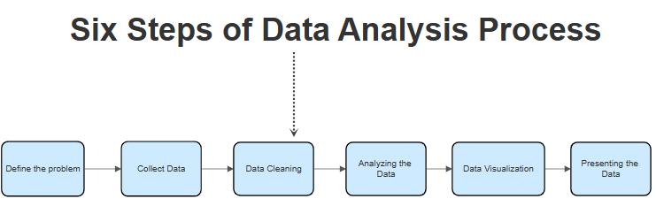

Slide 63
Define the Problem or Research Question
Collect Data
Data Cleaning
Analyzing the Data
Data Visualization
Presenting Data

Slide 64
What is business analytics?
Business analytics (BA) is a set of disciplines and technologies for solving business problems using data analysis, statistical models and other quantitative methods. It involves an iterative, methodical exploration of an organization's data, with an emphasis on statistical analysis, to drive decision-making.
Data-driven companies treat their data as a business asset and actively look for ways to turn it into a competitive advantage. Success with business analytics depends on data quality, skilled analysts who understand the technologies and the business, and a commitment to using data to gain insights that inform business decisions.

Slide 65
BA
Business analytics (BA) is a set of disciplines and technologies for solving business problems using data analysis, statistical models and other quantitative methods. It involves an iterative, methodical exploration of an organization's data, with an emphasis on statistical analysis, to drive decision-making

Slide 66
Types of business analytics
Different types of business analytics include the following:
• descriptive analytics, which tracks key performance indicators (KPIs) to understand the present state of a business;
• predictive analytics, which analyzes trend data to assess the likelihood of future outcomes; and
• Prescriptive analytics, which uses past performance to generate recommendations for handling similar situations in the future.

Slide 67
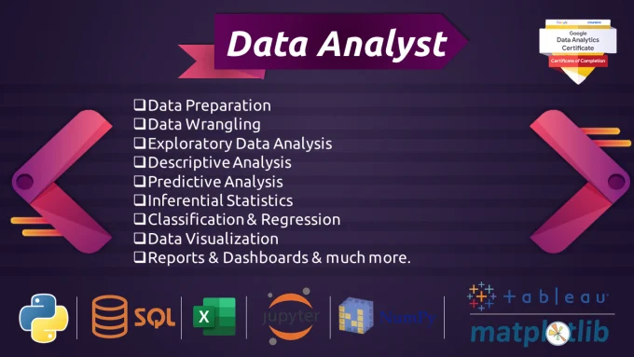

Slide 68
Data analytics
What is data analytics do?
Data analytics converts raw data into actionable insights. It includes a range of tools, technologies, and processes used to find trends and solve problems by using data. Data analytics can shape business processes, improve decision-making, and foster business growth.

Slide 69
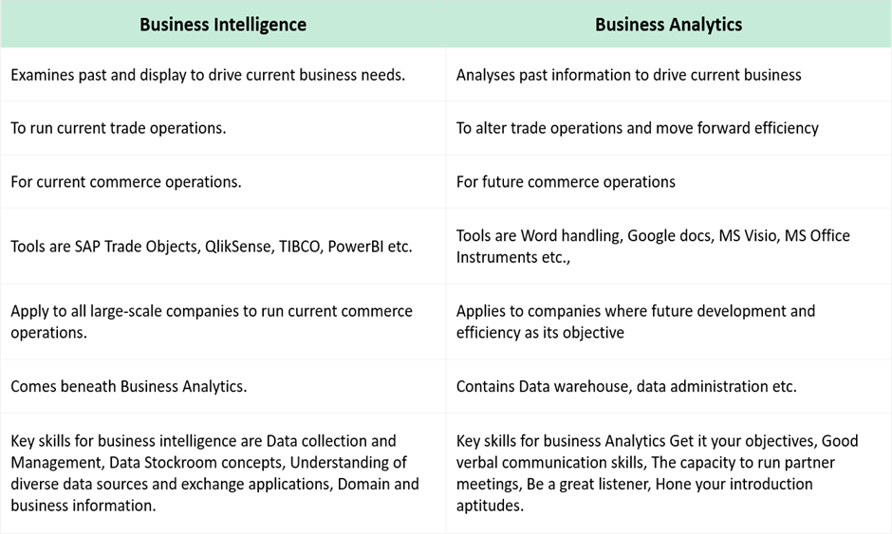
DIFFERENCES

Slide 70
Data analytics
How to study data analytics?
How to Become a Data Analyst (with or Without a Degree ...
How do I become a data analyst? A step-by-step guide
Get a foundational education. ...
Build your technical skills. ...
Work on projects with real data. ...
Develop a portfolio of your work. ...
Practise presenting your findings. ...
Get an entry-level data analyst job. ...
Gain certifications.

Slide 71
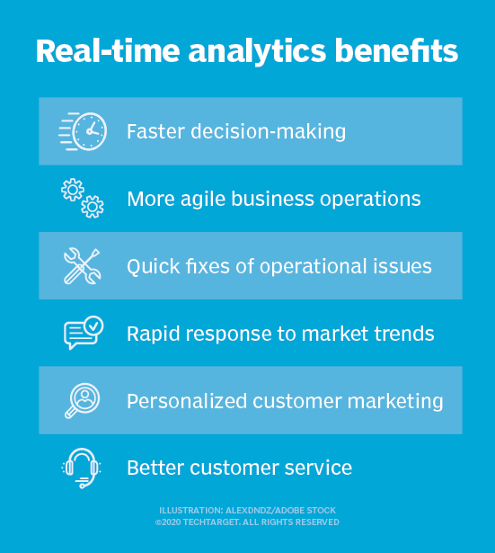
ANALYTICS

Slide 72
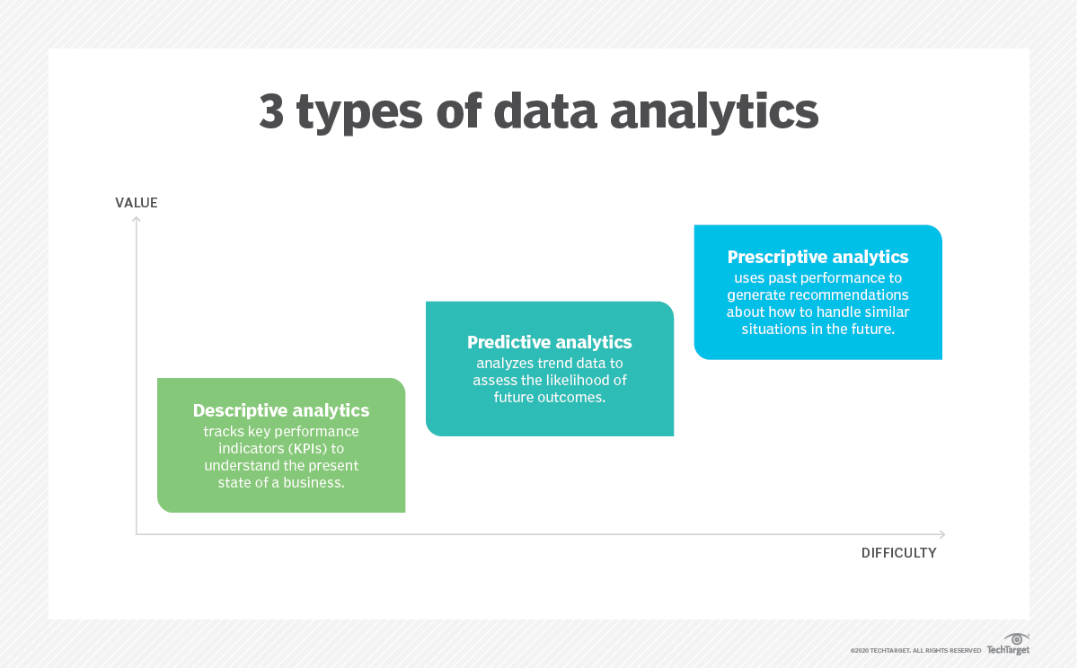
DATA ANALYTICS

Slide 73
What do you mean by business analytics?
Business analytics is the process of transforming data into insights to improve business decisions. Data management, data visualization, predictive modeling, data mining, forecasting simulation, and optimization are some of the tools used to create insights from data.

Slide 74
TYPES
What are the 4 types of business analytics?
Expertise in business analytics is essential if you want to use the information at your fingertips to help you make smarter business decisions. The four forms of analytics—descriptive, diagnostic, predictive, and prescriptive—help organizations get the most from their data.

Slide 75
